Slide 1

Muhammad Atif Saeed (Lecturer DS & AI)

Slide 2
DBSCAN Clustering
Clustering is an unsupervised learning technique where we try to group the data points based on specific characteristics. There are various clustering algorithms with K-Means and Hierarchical being the most used ones. Some of the use cases of clustering algorithms include:
Document Clustering
Recommendation Engine
Image Segmentation
Market Segmentation
Search Result Grouping
and Anomaly Detection.

Slide 3
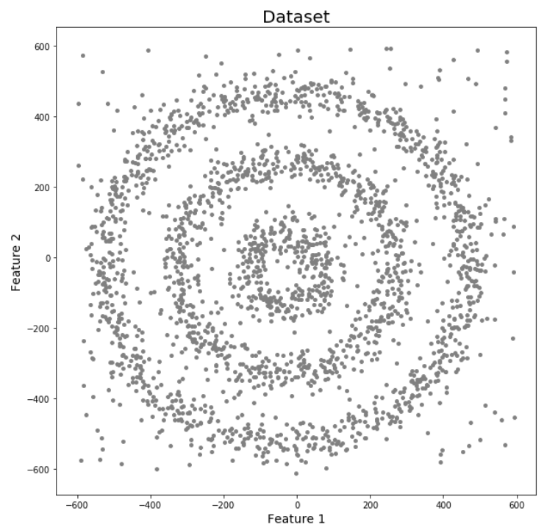
Why do we need DBSCAN Clustering?
K-Means and Hierarchical Clustering both fail to create clusters of arbitrary shapes. They are not able to form clusters based on varying densities. That’s why we need DBSCAN clustering.
Here we have data points densely present in the form of concentric circles:

Slide 4
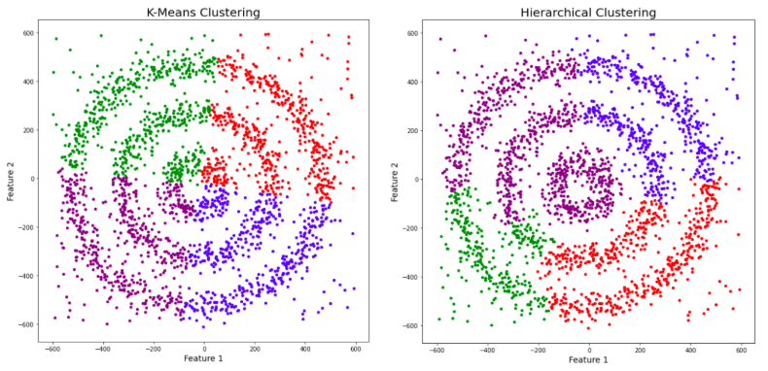
Why do we need DBSCAN Clustering?
Now, let’s run K-Means and Hierarchical clustering algorithms and see how they cluster these data points.

Slide 5
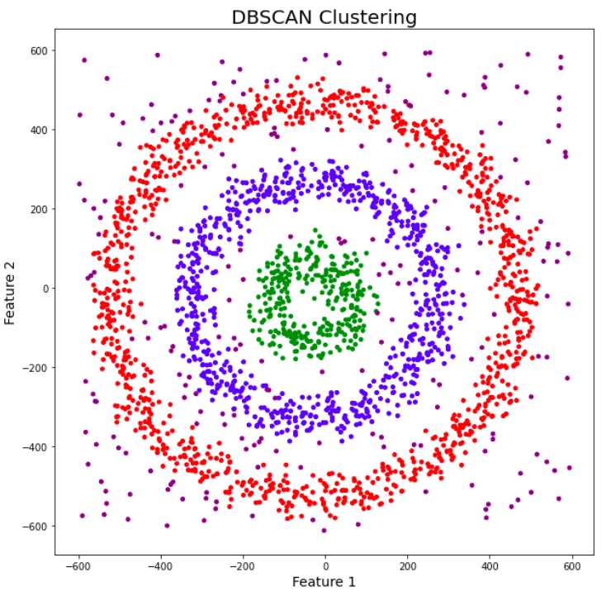
Why do we need DBSCAN Clustering?
Both of them failed to cluster the data points. Also, they were not able to detect the noise present in the dataset properly. Now, let’s take a look at the results from DBSCAN clustering.

Slide 6
What Parameters Required DBSCAN?
The DBSCAN algorithm relies on two main parameters to identify clusters in your data:
eps (ε): This parameter defines the radius of a neighborhood around a data point. Points within this distance are considered neighbors of the central point.
minPts: This parameter represents the minimum number of points required within the ε-neighborhood of a point to classify it as a core point. A core point is considered to be dense enough to be part of a cluster.

Slide 7
What Exactly is DBSCAN Clustering?
It groups ‘densely grouped’ data points into a single cluster. It can identify clusters in large spatial datasets by looking at the local density of the data points.
The most exciting feature of DBSCAN clustering is that it is robust to outliers. Unlike K-Means, where we have to specify the number of centroids, it also does not require the number of clusters to be told beforehand.

Slide 8
What Exactly is DBSCAN Clustering?
It groups ‘densely grouped’ data points into a single cluster. It can identify clusters in large spatial datasets by looking at the local density of the data points.
The most exciting feature of DBSCAN clustering is that it is robust to outliers. Unlike K-Means, where we have to specify the number of centroids, it also does not require the number of clusters to be told beforehand.

Slide 9
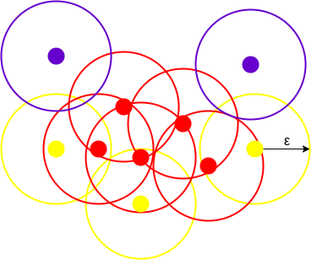
Example
DBSCAN algorithm creates a circle of epsilon radius around every data point and classifies them into Core point, Border point, and Noise.
A data point is a Core point if the circle around it contains at least ‘minPoints’ number of points.
If the number of points is less than minPoints, then it is classified as Border Point, and if there are no other data points around any data point within epsilon radius, then it treated as Noise.

Slide 10
What Exactly is DBSCAN Clustering?
The above figure shows a cluster created by DBCAN with minPoints = 3. Here, we draw a circle of equal radius epsilon around every data point. These two parameters help create spatial clusters.
All the data points with at least 3 points in the circle, including itself, are considered as Core points represented by red color. All the data points with less than 3 but greater than 1 point in the circle, including itself, are considered as Border points.
They are represented by yellow color. Finally, data points with no point other than itself present inside the circle are considered Noise, represented by the purple colour.

Slide 11
Reachability and Connectivity
Reachability states if a data point can be accessed from another data point directly or indirectly, whereas Connectivity states whether two data points belong to the same cluster or not. In terms of reachability and connectivity, two points in DBSCAN can be referred to as:
Directly Density-Reachable
Density-Reachable
Density-Connected

Slide 12
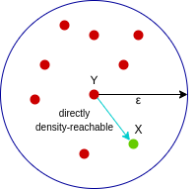
Directly density-reachable
A point X is directly density-reachable from point Y w.r.t epsilon, minPoints if,
X belongs to the neighborhood of Y, i.e, dist(X, Y) <= epsilon
Y is a core point
Here, X is directly density-reachable from Y, but vice versa is not valid.

Slide 13
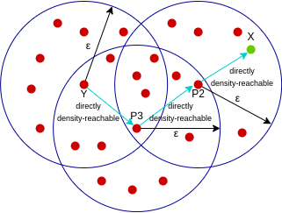
Density-reachable
A point X is density-reachable from point Y w.r.t epsilon, minPoints if there is a chain of points p1, p2, p3, …, pn and p1=X and pn=Y such that pi+1 is directly density-reachable from pi.
Here, X is density-reachable from Y with X being directly density-reachable from P2, P2 from P3, and P3 from Y. But, the inverse of this is not valid.

Slide 14
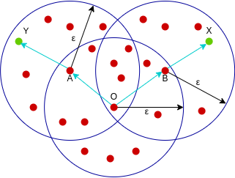
Density-connected
A point X is density-connected from point Y w.r.t epsilon and minPoints if a point O exists such that both X and Y are density-reachable from O w.r.t to epsilon and minPoints.
Here, both X and Y are density-reachable from O, therefore, we can say that X is density-connected from Y.

Slide 15
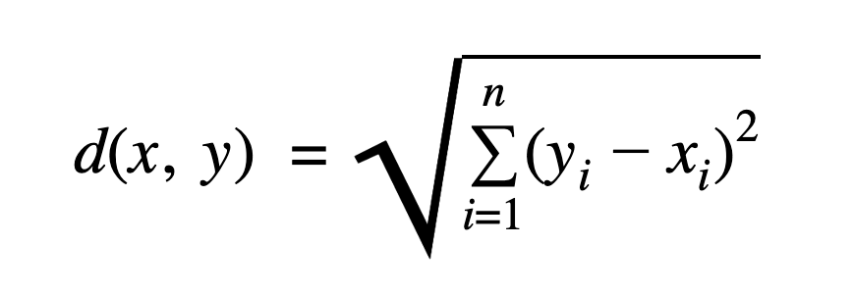
DBSCAN – Math Example
Cluster-Aish: A(1,2), B(1,3), C(2,2.5), H(2.5,2.2)
Cluster-Dish: D(8,8), E(8.5,8), F(9,8.5), I(9.5,9)
Suspected noise: G(0,8)
We’ll use Euclidean distance, ε = 1.2, MinPts = 3

Slide 16
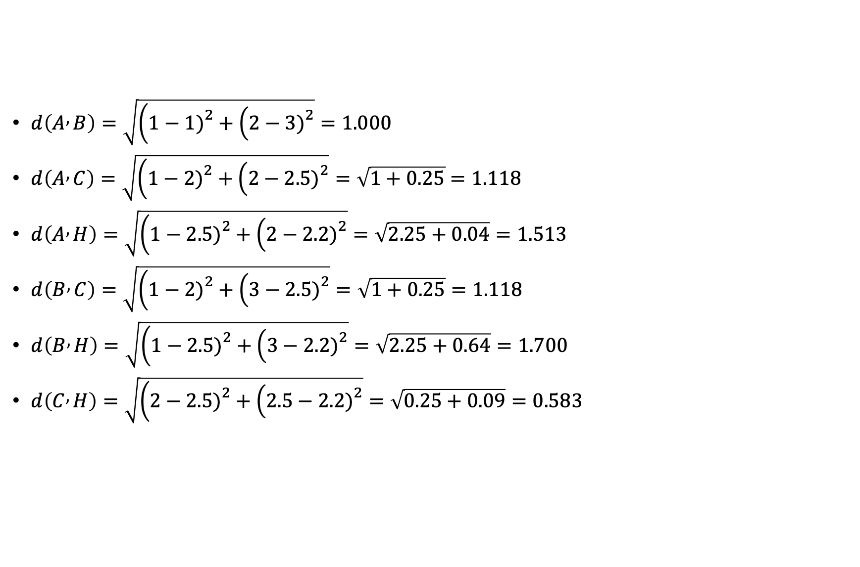
DBSCAN – Math Example
$d\left(A , B\right)=\sqrt{\left(1−1{\left.)\right.}^{2}+\left(2−3{\left.)\right.}^{2}\right.\right.}=1.000$
$d\left(A , C\right)=\sqrt{\left(1−2{\left.)\right.}^{2}+\left(2−2.5{\left.)\right.}^{2}\right.\right.}=\sqrt{1+0.25}=1.118$
$d\left(A , H\right)=\sqrt{\left(1−2.5{\left.)\right.}^{2}+\left(2−2.2{\left.)\right.}^{2}\right.\right.}=\sqrt{2.25+0.04}=1.513$
$d\left(B , C\right)=\sqrt{\left(1−2{\left.)\right.}^{2}+\left(3−2.5{\left.)\right.}^{2}\right.\right.}=\sqrt{1+0.25}=1.118$
$d\left(B , H\right)=\sqrt{\left(1−2.5{\left.)\right.}^{2}+\left(3−2.2{\left.)\right.}^{2}\right.\right.}=\sqrt{2.25+0.64}=1.700$
$d\left(C , H\right)=\sqrt{\left(2−2.5{\left.)\right.}^{2}+\left(2.5−2.2{\left.)\right.}^{2}\right.\right.}=\sqrt{0.25+0.09}=0.583$

Slide 17
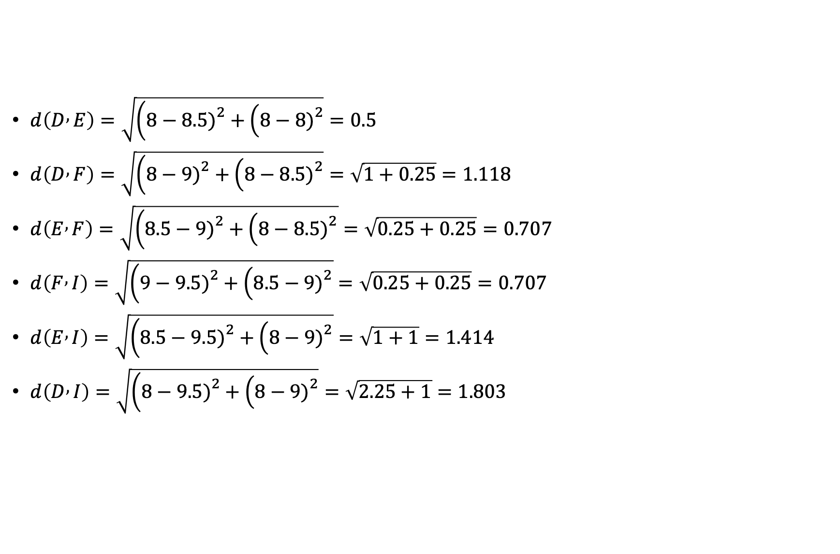
DBSCAN – Math Example
$d\left(D , E\right)=\sqrt{\left(8−8.5{\left.)\right.}^{2}+\left(8−8{\left.)\right.}^{2}\right.\right.}=0.5$
$d\left(D , F\right)=\sqrt{\left(8−9{\left.)\right.}^{2}+\left(8−8.5{\left.)\right.}^{2}\right.\right.}=\sqrt{1+0.25}=1.118$
$d\left(E , F\right)=\sqrt{\left(8.5−9{\left.)\right.}^{2}+\left(8−8.5{\left.)\right.}^{2}\right.\right.}=\sqrt{0.25+0.25}=0.707$
$d\left(F , I\right)=\sqrt{\left(9−9.5{\left.)\right.}^{2}+\left(8.5−9{\left.)\right.}^{2}\right.\right.}=\sqrt{0.25+0.25}=0.707$
$d\left(E , I\right)=\sqrt{\left(8.5−9.5{\left.)\right.}^{2}+\left(8−9{\left.)\right.}^{2}\right.\right.}=\sqrt{1+1}=1.414$
$d\left(D , I\right)=\sqrt{\left(8−9.5{\left.)\right.}^{2}+\left(8−9{\left.)\right.}^{2}\right.\right.}=\sqrt{2.25+1}=1.803$

Slide 18
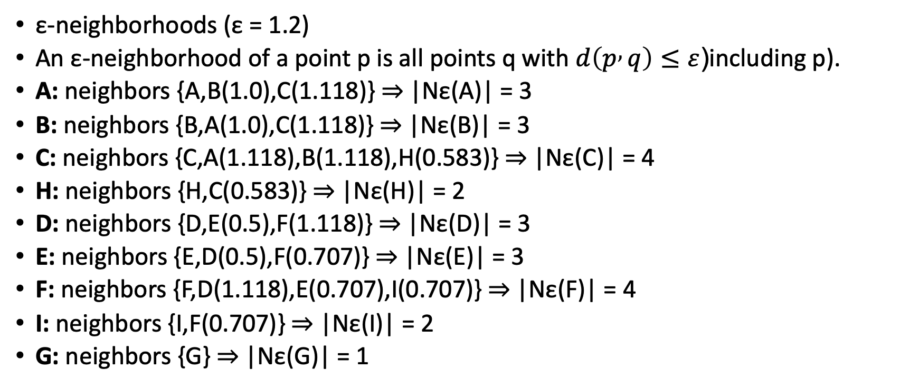
DBSCAN – Math Example
ε-neighborhoods (ε = 1.2)
An ε-neighborhood of a point p is all points q with $d\left(p , q\right)≤ε$(including p).
A: neighbors {A,B(1.0),C(1.118)} ⇒ |Nε(A)| = 3
B: neighbors {B,A(1.0),C(1.118)} ⇒ |Nε(B)| = 3
C: neighbors {C,A(1.118),B(1.118),H(0.583)} ⇒ |Nε(C)| = 4
H: neighbors {H,C(0.583)} ⇒ |Nε(H)| = 2
D: neighbors {D,E(0.5),F(1.118)} ⇒ |Nε(D)| = 3
E: neighbors {E,D(0.5),F(0.707)} ⇒ |Nε(E)| = 3
F: neighbors {F,D(1.118),E(0.707),I(0.707)} ⇒ |Nε(F)| = 4
I: neighbors {I,F(0.707)} ⇒ |Nε(I)| = 2
G: neighbors {G} ⇒ |Nε(G)| = 1

Slide 19
DBSCAN – Math Example
Core / Border / Noise
Core point: |Nε(p)| ≥ MinPts (=3 here)
Border point: not core, but within ε of a core point
Noise: neither core nor border
From the counts:
Core: A, B, C, D, E, F
Border: H (within ε of core C), I (within ε of core F)
Noise: G

Slide 20
Density reachability & cluster construction
DBSCAN expands clusters from cores by adding all points density-reachable (via chains of ε-neighbors through cores).
Pick A (unvisited). Core ⇒ start Cluster 1 = {A}.
Add its ε-neighbors: {B, C}. Now {A,B,C}.
Visit B (core). Add its ε-neighbors (A,C) — already in cluster.
Visit C (core). Add its ε-neighbors (A,B,H). H is new ⇒ add H.
H is border (not core), so do not expand from H.
Cluster 1 finalized: {A, B, C, H}

Slide 21
Density reachability & cluster construction
Cluster 2 (continue with next unvisited core, D):
Pick D (core). Start Cluster 2 = {D}; add ε-neighbors {E,F}. ⇒ {D,E,F}
Visit E (core). ε-neighbors {D,F} already in cluster.
Visit F (core). ε-neighbors {D,E,I}. I is new ⇒ add I.
I is border; do not expand from it.
Cluster 2 finalized: {D, E, F, I}
Remaining point
G never added ⇒ noise.

Slide 22
Density reachability & cluster construction
Cluster 2 (continue with next unvisited core, D):
Pick D (core). Start Cluster 2 = {D}; add ε-neighbors {E,F}. ⇒ {D,E,F}
Visit E (core). ε-neighbors {D,F} already in cluster.
Visit F (core). ε-neighbors {D,E,I}. I is new ⇒ add I.
I is border; do not expand from it.
Cluster 2 finalized: {D, E, F, I}
Remaining point
G never added ⇒ noise.

Slide 23
Distance matrix
 | A | B | C | H | D | E | F | G | I
A | 0.000 | 1.000 | 1.118 | 1.513 | 9.220 | 9.605 | 10.308 | 6.083 | 11.011
B | 1.000 | 0.000 | 1.118 | 1.700 | 8.602 | 9.014 | 9.708 | 5.099 | 10.404
C | 1.118 | 1.118 | 0.000 | 0.583 | 8.139 | 8.515 | 9.220 | 5.852 | 9.925
H | 1.513 | 1.700 | 0.583 | 0.000 | 7.993 | 8.345 | 9.052 | 6.316 | 9.759
D | 9.220 | 8.602 | 8.139 | 7.993 | 0.000 | 0.500 | 1.118 | 8.000 | 1.803
E | 9.605 | 9.014 | 8.515 | 8.345 | 0.500 | 0.000 | 0.707 | 8.500 | 1.414
F | 10.308 | 9.708 | 9.220 | 9.052 | 1.118 | 0.707 | 0.000 | 9.014 | 0.707
G | 6.083 | 5.099 | 5.852 | 6.316 | 8.000 | 8.500 | 9.014 | 0.000 | 9.552
I | 11.011 | 10.404 | 9.925 | 9.759 | 1.803 | 1.414 | 0.707 | 9.552 | 0.000

Slide 24
Customer | Session Duration (min) | Sessions / Week
U1 | 30 | 8
U2 | 32 | 9
U3 | 29 | 7
U4 | 31 | 8
U5 | 33 | 9
U6 | 60 | 15
U7 | 62 | 14
U8 | 58 | 16
U9 | 61 | 15
U10 | 63 | 14
U11 | 15 | 3
U12 | 16 | 4
U13 | 14 | 3
U14 | 45 | 10
U15 | 90 | 2
An e-commerce company wants to analyze user activity patterns on its platform to identify dense engagement zones and detect inactive or abnormal users.
Each data point represents a customer summarized by two behavioral features:
Average Session Duration (minutes)
Number of Sessions per Week
DBSCAN Parameters
ε (epsilon) = 3
MinPts = 4
Distance metric: Euclidean distance

